Slide 1
Sustainable Development Goals– UAE’ Case Study
The implementation of the UN 2030 is extremely crucial for the Arab region, which is facing the fundamental and diverse challenges associated with SDG. Diagnose the challenges facing their societies regarding the three pillars of sustainable development: economic development, social justice, and environmental sustainability.

Slide 2
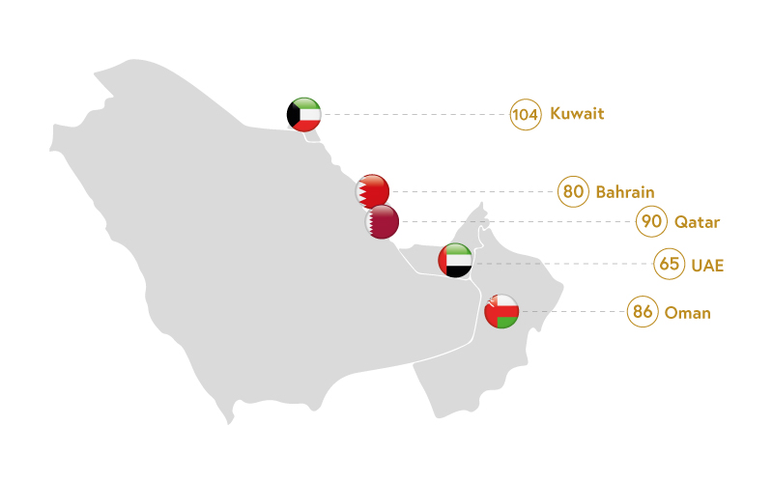

Slide 3
The Arabic region is very diverse. Somalia, Sudan and Yemen are countries in which there is extreme poverty, requiring the satisfaction of basic needs, including those in which there are armed conflicts. Other countries in the conflict are Iraq, Lebanon, Libya, Palestine and Syria.
In contrast, Algeria, Kuwait, Qatar, Saudi Arabia and the United Arab Emirates face the challenges of fossil fuel conversion to renewable energy.
Analysing the Arab region, almost all this area is experiencing a lack of freshwater.

Slide 4
Due to immigration, the United Arab Emirates has one of the highest increases in the world's population. As a result, the very rapid development of cities follows. Therefore, the UAE authorities, in order to protect the environment and striving to increase the quality of life, have decided to implement programs for sustainable cities.
One example is the compulsory Estidama program ('sustainable development' in Arabic), which is a key element of 'Abu Dhabi Vision 2030', providing the highest green standards in the design, construction and management of buildings and communities in a sustainable manner. Estidam is one of the first such programs for sustainable development in the Middle East

Slide 5
Vision 2021
The government of the United Arab Emirates in 2010 announced UAE Vision 2021, which assumes reliance of economic development on "a diversified and knowledge-based economy". The goal of the national Vision 2021 strategy is to achieve in 2021, the year of the golden jubilee of the founding of the state, the position of one of the best countries in the world. This National Agenda has been based on several key areas, i.e. education, health, economy, police and security, housing, and government infrastructure and services.

Slide 6
The strategy, first of all, faces 3, 7, 8, 9 SDG’ as well as 16. The UAE aims to achieve the rank of one of the best countries in the world in the ranking of Social Development Index in 2021. Therefore, in 2016, the Ministry of Happiness was established. To this end, it promotes a healthy lifestyle along with the development of a high-level health system.

Slide 7
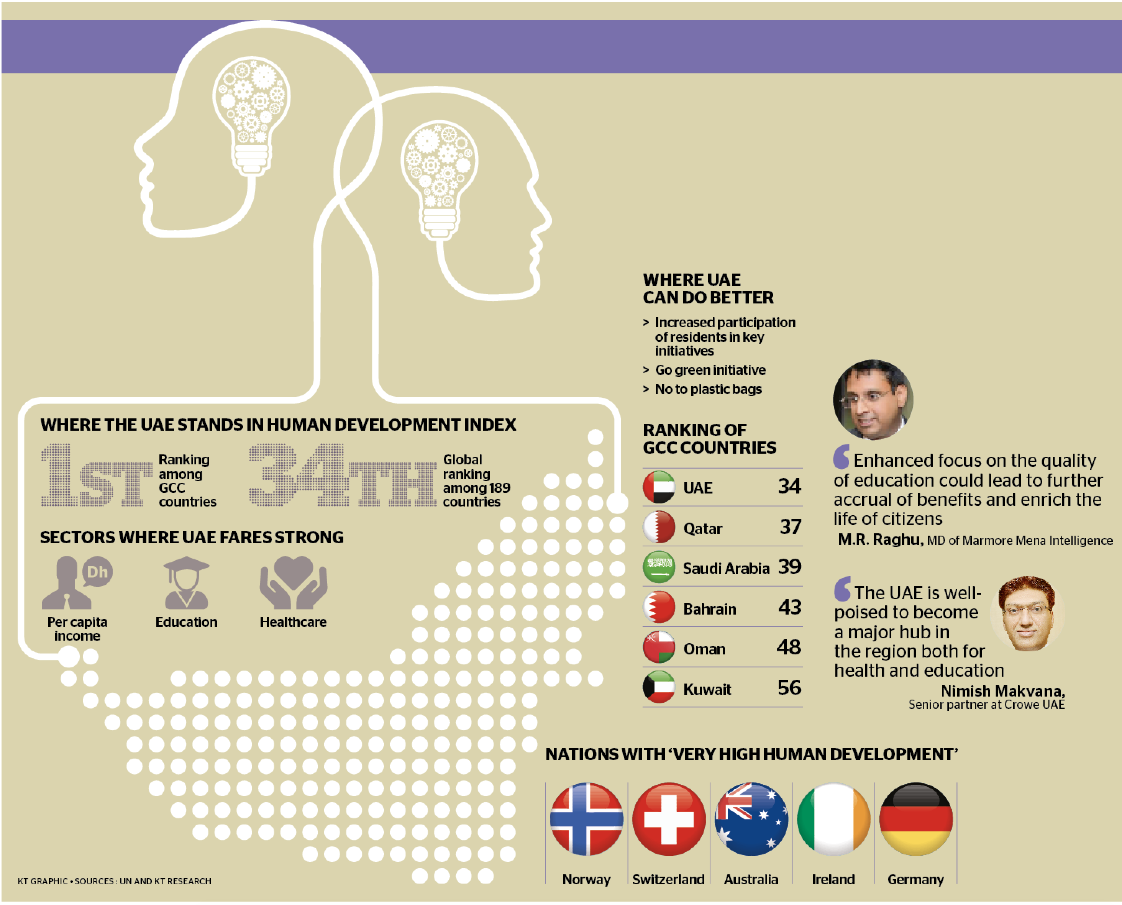

Slide 8
Health care as an element of SDG 3 is one of the pillars of Vision 2021. In 2019, the UAE government allocated USD 14.2 billion, 11.2% of the federal budget for the health sector. Besides, the UAE improves business conditions to attract more foreign investments. According to Vision 2021, the UAE is to be a centre for economic, commercial and tourism for over two billion people. An important element of the strategy to achieve this goal is a knowledge-based economy with a focus on innovation, research and development. Also, the UAE has invested more than USD 840 million in renewable energy in more than 30 countries.

Slide 9
The UAE have a highly developed infrastructure, at the same time focuses on air quality, water resources, increasing the share of clean energy and implementing green plans (UAE Government, Vision 2021). One of the areas of Vision 2021 is security and stability, which meets the SDG 16. From the very beginning, the UAE is involved in the international arena in building security and peace in both a regional and global dimension. Moreover, UAE Vision 2021 sets out judicial and security objectives that focuses on strengthening security by expanding the potential of security services and achieving the UAE's judicial system's position as one of the most effective in the world. At the same time, the UAE dynamically strengthens its role and position in the world.

Slide 10
A green economy for sustainable development
The Vision 2021 strategy shows the will of the UAE to move away from oil as the main source of income. In January 2012, the authorities introduced a "green economy" program under the slogan: "Green economy for sustainable development". Its goal is the sustainable development of the UAE by increasing their competitiveness and creating a global new model of a green economy. UAE is to become the global leader of new green technologies, adopting appropriate policies and leading numerous programs. The green economy plan covers a wide range of policies, laws and numerous programs and projects primarily in the area of renewable energy development; investments in the green economy and then facilitating the production, import, export and re-export of green products and technologies.

Slide 11
The next area is the urban policy, whose task is to protect the environment and increase the ecological dimension of housing and buildings. The next area is activities related to meeting climate change, including the promotion of organic farming and the protection of biodiversity and ecological balance. The fifth area is the rationalization of the use of water resources, electricity, natural resources and waste recycling. To implement activities in these areas, the UAE decided to develop and promote green technologies. In the energy area, until 2030 UAE are working on increasing the share of clean energy to 30 per cent.

Slide 12
1. Competitive Knowledge Economy
1.1 National Green Innovation Program | Licensing and accrediting professional training program in green fields
 | Student scholarships for environmental courses in higher education
 | Financing studies and research on green specialties Research initiatives that support the emergence of a knowledge-based green economy
1.2 Green Diversification Program | Incentive packages for supporting green manufacturing National program on awareness raising and education of green manufacturing Include focus on green industries in industrial development strategies
 | Develop rules and national indicators on green manufacturing
 | Financing program for green industries Policy on integrated management of industrial waste
The UAE Green Agenda Programs (2015-2030)

Slide 13
2. Social Development & Quality of life
2.1 Integrated Green Infrastructure Program | Continued development of integrated urban planning Study on environmentally sensitive areas and heat island effect National program on sustainable buildings and construction
 | Legislation on sustainability and environmental consideration in road infrastructure
 | Application of international standards and sustainable energy for public housing projects
 | Policy support for procuring and developing green building materials
 | Legislation for rationalization of energy and water consumption in existing buildings
 | Project on autonomous houses Application of sustainability standards in residential complexes Global partnerships for energy conservation
2.2 Green Workforce & Talent Program | Integration of green economy and sustainable development in school curriculum
 | Classification of green jobs under the existing job categorization Introduction of new vocational training courses at the national and local levels
 | Incentives and promotion of green jobs for new graduates Promote partnership between academia and industry

Slide 14
3. Sustainable Environment & Valued Natural Resources
3.1 Natural Capital & Resilience Program | Monitor and control groundwater level and quality Regulate groundwater exploitation through drilling permits Environmental impact assessment of development projects Develop and implement a climate change adaptation strategy
 | Monitor and manage terrestrial and marine habits
 | Blue Carbon projects National Smart Natural Capital & Resilience program Fisheries sector’s change management
 | Manage and monitor coastal and marine environment
 | Regulate and monitor sewage discharge Air quality monitoring and controlling
3.2 Environmental Goods & Services Program | Develop national eco-labels for products and services
 | Program to improve added value in the global value chain of environmental goods and services (EGS) Safeguard policies for the emerging EGS sector
 | Promote EGS exports and capacity development
 | Green public procurement policy

Slide 15
4. Clean Energy & Climate Action
4.1 Integrated Power & Water Management Program | Integrated energy management strategy Integrated water management strategy
 | Promoting optimal design in power stations Upgrading gas turbines in water desalination units Reducing transmission loss in electricity networks
4.2 National Renewable Energy Program | Mega solar PV projects
 | Advancing concentrated solar power (CSP) deployment Programs promoting rooftop solar energy Water and electricity tariff review Further dissemination of district cooling systems
4.3 National Green Economy Data Program | Energy Data Management and Automation project Monitoring, reporting and verification (MRV) system on greenhouse gas (GHG) emissions National Communications on GHG emissions to UNFCCC Periodic public reports on GHG emissions and other data
 | Identification and collection of environmental data Identification and collection of economic and social data Development of integrated electronic database on economic, social and environmental data Further refinement and regular monitoring of Green KPIs
 | Regular compilation of the UAE State of Green Economy Report

Slide 16
5. Green Life & Sustainable Use of Resources
5.1 National Energy & Water Efficiency Program | National program on efficiency of water and electricity consumption
 | Monitoring system of water control equipment
 | Water and energy efficiency standards and labeling Demand-side water and energy management strategies and policies Smart metering and smart grid projects
5.2 National Waste-to Resource Program | Strategies and legislation for integrated waste management
 | Legislation on environmental requirements in landfills
 | Setting environmental requirements in waste-to-energy plants Legislation on safe disposal of used batteries Legislation on proper disposal of obsolete pesticides
 | Integrated waste management projects in the Northern Emirates
5.3 National Sustainable Transport Program | Integrated transport plans
 | Low-emission zones Consideration of alternative modes of transport in urban planning
 | Introducing Intelligent Traffic Management Systems
 | Specification of efficiency and emissions of cars and phasing out inefficient vehicles
 | Development of technical standards that support the introduction of green vehicles
 | Promote responsible behaviour and sustainability in road transport
 | Incentive schemes for the use of alternative fuels Awareness campaigns on sustainable transport

Slide 17
Innovation and Sustainable Cities
The United Arab Emirates have been striving for the acquisition and introduction of new information and communication technologies in the country for years. Therefore, free zones were established related to this area, including, inter alia, in 1999, Dubai Internet City, next year, Dubai Media City, and in 2005, Dubai Silicon Oasis. Besides, in 2007 the Telecommunications Regulatory Authority established the ICT Fund, the first such fund in the Arab world, to co-finance IT and technology projects aimed at increasing the UAE's potential in this field. Moreover, local telecommunications operators are required to transfer 1% of net profit to the fund (TRA, 2019).

Slide 18
Dubai executing the Smart Dubai program which can be an example for many cities in the world in implementing new projects and creating the city of the future. Projects such as artificial intelligence applications, 3D printing, drones, robotics, wearable devices, driverless vehicles, IoT sensor systems, and advanced analytics are implemented in cooperation between governmental and private entities as well as the scientific community. According to Salem, the implementation of the Smart Dubai program causes a process of long-term socio-cultural changes that are part of a comprehensive digital transformation, including the approach to the environment and sustainable development

Slide 19
The National Strategy for Innovation
In September 2014, the Mohammed bin Rashid Center for Government Innovation was created to build a culture of innovation in governmental administration. This initiative should contribute to making the UAE as one the most global innovative government. In October 2014, the National Innovation Strategy was adopted to make the UAE as one of the most innovative countries in the world until 2021, as well as facing SDG’, among others 3rd and 9th goals. The strategy focuses primarily on seven areas. The first of them is renewable energy. Authorities seek to coordinate many projects in this field, as well as to support innovation in the renewable energy sector, and to conduct research on clean technologies.

Slide 20
The next area is transport, in which the state intends to provide new innovative services and products coordinated with the entire logistical infrastructure. The next strategic area is education, in which students have to achieve a high level of critical thinking, creativity and adaptability. Another area is health, which is to be equipped with top-class technologies for medical services and development of medical research, especially for the biotechnology and pharmaceutical industries.
The fifth sector is related to water-related to its shortage, under which the UAE is looking for innovative solutions. To support these areas, the strategic emphasis new technologies. The seventh sector is the space within building the space industry with new technology related to exploration and satellite communications

Slide 21
Then, one month after the announcement of the National Innovation Strategy, in November 2015, the UAE authorities set up the Innovation Financing Fund, allocating over USD 610 million to finance projects related to the implementation of the strategical objectives.
On the 4th of March 2015, as a part of the implementation of the strategy, H.H. Sheikh Mohammed bin Rashid, the UAE’s Prime Minister announced plans for major new Museum of the Future, which should attract world’ top researchers, designers, inventors and financiers to produce new ideas, innovations as well as futuristic visions to create the better global future. This initiative is to focus primarily on such areas as energy, transport and 3D construction techniques, smart cities, health, education.

Slide 22
H.H. Sheikh Mohammed, Bin Rashid Al Maktoum, ruler of Dubai in April 2016, launched the Dubai 3D Printing Strategy, which assumes achieving 25 per cent of construction objects from 3D printing until 2030. According to specialists in this field, thanks to 3D printing technology, construction of buildings can be shorter between 50 and 70 per cent and reduces labour costs from 50 to even 80 per cent. Besides, in the context of environmental protection, 3D can contribute to the reduction of construction waste by 30-60 per cent. All this is an important element contributing to sustainable development

Slide 23
In May 2016, the world's first 3D printing office building with an area of 250 square meters was put into use in Dubai. It was printed in 17 days and a built-in 48 hours, at a lower cost of labour by 50 per cent. This building should be the world centre for the development of 3D technology and the Dubai Future Foundation. The completed project is part of the Dubai 3D Printing Strategy, which assumes by 2030 a level of 25 per cent of all construction objects in Dubai emirate to be printed in 3D technology. In 2016, HH Sheikh Mohammed also approved the creation of the USD 272 million Future Endowment Fund for investing in innovation and shaping the future of strategic sectors.

Slide 24
Sustainable Infrastructure and cities
To make cities inclusive, safe, resilient and sustainable (goal 11) as well as ensure sustainable consumption and production patterns (goal 12), the UAE have taken a lot of projects. Since 2009, Abu Dhabi has been the host of the International Renewable Energy Agency (IRENA), which is the first intergovernmental organization based in the Middle East. IRENA's goal is to support countries in the transition to a sustainable energy future and serves as the main platform for international cooperation in the field of renewable energy. On the road to achieving sustainable development, energy security, including the development of renewable energy, IRENA strives for the widest possible use of the geothermal, hydro, ocean, solar and wind energy in the world.

Slide 25
In 1970 Dubai was inhabited by 80,000 people. In 2015, around 3.5 million people were already running a business in Dubai. The United Arab Emirates are building several sustainable cities that save energy and use renewable energy using new innovative technologies and pioneering architectural projects. In Abu Dhabi, Masdar City is the first attempt to build a sustainable city in the Middle East. Masdar City strives to reduce energy and water consumption as well as production waste by achieving environmental protection objectives. For this purpose, among others, it uses a combination of technologies, architectural designs and solar energy.

Slide 26
In Masdar City, there is the headquarters of the International Renewable Energy Agency, an intergovernmental organization that strives for a globally sustainable energy future. Masdar in Abu Dhabi has two global ventures: Masdar Clean Tech Fund and DB Masdar Clean Tech Fund. These funds invest in the most innovative and pioneering companies in the world in the field of clean technology and renewable energy. The United Arab Emirates have applied many projects to reduce the impact of waste on the environment and human health, and their application in the process of generating energy. In order to develop the waste sector for the energy of the UAE, the Masdar company, which deals with renewable energy in Abu Dhabi, in a strategic partnership with Beeah is to contribute to the vision of the government of the UAE in 2021 and lead to the transfer of waste from landfills by 75% by 2021. Also, Masdar announced in 2013 a pilot project of advanced energy-saving desalination, the aim of which is to develop and demonstrate desalination technologies for seawater that are sufficiently efficient to be powered by renewable energy.

Slide 27
In Dubai, following the objectives of the Dubai Plan 2021 is to make Dubai an intelligent and sustainable city. In line with this strategy, Dubai builds several sustainable districts - cities such as the Balanced City; Desert Rose City; Dubai South District; Dubai Silicon Oasis. By the second quarter of 2020, Dubai will have the largest plant in the Middle East for 545 million USD, which will turn waste into energy. In 2014, the authorities of Dubai adopted the Smart City Strategy. This strategy assumes the optimization of energy use, smarter means of transport and recreation areas. The housing estate in Dubai, named Sustainable City, will be powered by solar energy produced locally. Residences, offices and other properties will be equipped with energy-saving devices.

Slide 28
Besides, the estate is to be free of cars, there are 10,000 trees and organic farms. Another example of a sustainable city in the Emirate of Dubai is Desert Rose City, whose architecture is shaped like a rose desert that allows it to reduce electricity consumption. Also, this city will be able to produce renewable energy and waste recycling. In Desert Rose City, there are 30,000 homes to live in. The next project, which is the Dubai Silicon Oasis (DSOA), has managed to reduce energy consumption by 31 per cent. Additionally, more than is provided for in Dubai Integrated Energy Strategy 2030 (30 per cent). Besides, DSOA is introducing many projects against the Dubai strategy of clean energy in 2050. One example is the use of intelligent building technologies, such as installation in buildings of sensors managing energy consumption.

Slide 29
It estimated the value of the global market for smart cities by 2020 between USD 408 billion and USD 1.56 billion. Dubai implementing programs related to the city of the future can be an important global centre of new solutions in this area.

Slide 30
UAE Energy Strategy
The first UAE-fixed contribution to the Paris Agreement of 2015 on climate change aims to increase clean energy - nuclear and renewable energy - up to 24% of total energy production by 2021. However, the United Arab Emirates have a more ambitious target for 2050 44% in the field of renewable energy production. This goal will still have to be supported by ambitious intermediate goals to guide policy and investment in the coming decade

Slide 31
In 2017, the UAE announced the first unified energy strategy "Energy Strategy 2050", which aims to increase the share of clean energy by 2050 from 25% to 50%. Besides, the UAE wants to reduce the carbon footprint of energy production by 70%. The implementation of this goal should save up to USD 190 billion by 2050 and during this time, invest USD 163 billion. The one who does not think about energy does not think about the future - said Sheikh Mohammed. The strategy assumes, by 2050, a level of energy recovery of 44% of clean energy, 38% of gas, 12% of pure coal and 6% of nuclear energy. Also, the strategy is to reduce energy consumption in residential buildings by 40 per cent. In January 2015, Dubai announced an integrated energy strategy in Dubai 2030, which concentrates resources and efforts on increasing the share of renewable energy, reaching by 2020 7% and 2030 15%.

Slide 32
Dubai is the only city in the region that has adopted a strategy for the development of new future-oriented solutions in the energy sector up to 2050. The strategy is based on five main pillars: infrastructure, relevant legislation, funding, building and skills capabilities and an environmentally friendly energy mix. One of the most important projects in the area of infrastructure is the Mohammad bin Rashid Al Maktoum solar park announced in January 2012.

Slide 33
This venture is the largest unit solar project in the world, the cost of which is to amount to 14 billion USD. Moreover, its planned total production capacity, which is 5,000 megawatts (MW), to be achieved by 2030. This project will have an impact on sustainable development. Dubai has become a global leader in developing clean and renewable energy. The Emirate has introduced many programs to improve the effectiveness of the energy sector efficiency, including the rationalization of energy consumption and the use of alternative solutions also for conventional energy.

Slide 34
Further development is the Clean Energy Strategy in Dubai in 2050, which aims to produce 75% of Dubai's energy from clean sources by 2050. Dubai until 2050 is going to be the city with the lowest carbon footprint in the world. The implementation of the adopted programs and strategies, including, inter alia, UAE Vision 2021, UAE Centennial 2071, and Dubai Plan 2021, will contribute to this goal. The Al Mohammed bin Rashid Al Maktoum solar park is to a large extent contributing to this vision. 22 October 2013 was launched the first stage of operation of this project.
On March 20, 2017, the project entered the second stage of operation with 200MW, becoming the largest venture of its kind in the region, having the capacity to supply clean energy to 50,000 homes in the Emirate, while reducing 214,000 tonnes of carbon emissions annually. Then, on May 1, 2018, we entered the third period of the project, which is expected to last until 2020 and provide 60,000 homes with clean energy.

Slide 35
On November 3, 2018, Dubai Electricity and Water Authority decided to increase the fourth phase from 700 MW to 950 MW by adding new photovoltaic solar panels. Besides, the fourth stage has already recorded many records. One of them is 260 meters high, the world's highest solar tower, thanks to which the abovementioned capacity will be increased. The solar park will reduce the carbon footprint while increasing the efficiency of using natural resources and reducing the carbon footprint. Thus, thanks to the solar park project, Dubai will help reduce the cost of solar energy around the world. UAE has attracted many foreign investments in this sector. Also, it is an important initiative for CSR and contributes to sustainable economic development. As indicated by the Nikkei Asian Review report, the UAE effort in the field of renewable energy has an impact on reducing its global costs

Slide 36
The UAE and the climate change
In global actions to counteract climate change, the countries of the Gulf Cooperation Council (GCC) are more and more involved. Some GCC governments, like the UAE, play an important role in these activities. Most GCC countries have adopted economic diversification strategies as a key element in combating climate change. One example is Saudi Arabia and its Vision 2030 and the 2020 program assuming investment and dynamic development of renewable energy.

Slide 37
the Paris Agreement has a number of direct and potential indirect consequences for the UAE, including a requirement to communicate a ‘nationally determined contribution’ (NDC), which must contain greenhouse gas (GHG) emissions reduction or limitation measures. Potential in economic opportunities that arise from a more predictable investment climate for clean energy and sustainable infrastructure resulting from universal participation in the implementation of the Paris Agreement, as well as potential long term impacts on the demand for, and price of oil

Slide 38
In order to face goal 13, to take urgent action to combat climate change and its impacts. In 2014, the UAE, is globally active, in cooperation with the US initiated the annual bilateral energy dialogue. That is why in May this year UAE organized Abu Dhabi Ascent, hosting representatives of governments, the private sector and non-governmental organizations from all over the world to give a new dynamic of discussion and activities related to climate change. In addition, the UAE in December 2015 during the United Nations Conference on Climate Change, COP 21 declared that 24% of its electricity from clean energy sources should be made by 2021.

Slide 39
In order to strengthen the UAE's policy and strategy on climate change, the environment and sustainable development, in 2016 the UAE has established the Council on Climate Change and Environment. The internal council is to develop plans for achieving environmental goals. In the international arena, however, it is responsible for representing the UAE and conducting regional and global negotiations. In addition, the Council is to make scientific research more dynamic in areas related to climate change, the environment and sustainable development, and establish cooperation with the private sector

Slide 40
In 2017, in order to effectively achieve global goals in the local dimension, the UAE authorities established a National Committee for Sustainable Development Goals, which included 17 governmental institutions. The head of the committee has been Reem Al Hashimy, Minister of State for International Cooperation and, inter alia, the head of Expo2020 Dubai. The aim of the committee's work is to coordinate and monitor activities in fulfilling strategic tasks related to sustainable development, both locally and internationally. With reference to Agenda 2030, in 2018, the UAE set up a Private Sector Advisory Board on sustainable development objectives, whose objective is close cooperation between the government and the private sector to achieve the SDG UN. The new council includes outside governmental institutions, the most important private companies representing various sectors

Slide 41
One of the largest parts of the global population is the youth population of 1.8 billion people. Long-term strategies relate primarily to the next generations. Therefore, at the beginning of 2018, the UAE Youth Advisory Council on Sustainable Development Goals also started its activity. The goal of the council is to involve young generations as responsible ones for the future and to include their innovative ideas in relation to future challenges

Slide 42
During the World Government Summit 2018 in Dubai, the UAE announced the creation of Global Councils for SDG for global cooperation to fulfil the SDG. The global council's president was nominated also Reem Al Hashimy. The Council is a global network of governmental decision-makers, international organizations, representatives of science and the private sector. Each council has its own chairman and up to 15 members from different countries and environments. All councils are to work closely together to achieve 17 sustainable development goals at both local and global levels. Global Councils take various initiatives. One example is work for SDG 16 (on peace, justice and strong institutions).

Slide 43
Board members initiate programs regarding the inclusion of new generations and institutions for discussion and sharing innovative ideas aimed at achieving global peace. Lootah shows another example is the commitment to fill SDG 3 (on good health and well-being) by trying to develop a universal health care system for people around the world who do not have such guarantees. The UAE's initiative to set up a global network of councils and be the head of the representative of this country shows the leading role of the UAE in fulfilling the goals of sustainable development in the country and in the world.

Slide 44
Conclusion
Dubai should be a model for others, especially large GCC countries in the active participation of C40, Global Compact of Mayors, or other city networks. In addition, the city of GCC countries should work closely together. When it comes to combating climate change, GCC cities have similar challenges, such as rising sea levels or desalination.
The main interest of the UAE is being a global energy supplier, including investing in renewable energy programs. Moreover, the UAE ensure the security of supply of critical materials and technologies for the energy sector as well as ensuring economic prosperity through a diversified economy, including by building clean energy sectors.

Slide 45
In the period from October 2021 to April 2022, the Expo 2020 will take place in the Dubai South District. Sustainability is one of the themes of this global event. The hosts have founded and designed that half of the electricity consumed by Expo2020 Dubai will be supplied from completely renewable sources. In addition, half of this energy will be generated at the site of the event. In addition, most of the materials used for the construction of Expo facilities will be used again for the building infrastructure. What's more, sustainable development is one of the main themes of Expo 2020 Dubai.

Slide 46
Dubai has launched a series of initiatives in efforts to revolutionize its transportation sector. The major aim is to boost the economy through enhanced mobility, efficient travel and the tackling of traffic congestion. Moreover, a parallel objective is to build a better quality of life through the reduction of the Emirate’s carbon footprint. The ‘Green Economy for Sustainable Development Initiative’ aims to raise the quality of life in the city by promoting environmentally friendly products.
The ‘Dubai Green Mobility Initiative’ aims to establish a market for electric and hybrid vehicles in the Emirate and contribute to a 19 per cent reduction in carbon emissions by 2021. The ‘Dubai Smart Autonomous Mobility Strategy’ speaks of the government’s effort to become a leader in the field of driverless commuting. The strategy aims to have 25 per cent of all journeys in Dubai to be driverless by 2030. The movement towards efficient mobility does not stop there as the city plans to operationalize the first ‘flying taxi’ and is participating in the ambitious ‘Hyperloop One’ project.

Slide 47
It must be said that our world, with financial resources and technology, knows how to achieve the goals of sustainable development. However, progress to date is too weak. Many countries are engaged in other challenges, such as prolonged wars and conflicts and the effects of major disasters - including those related to the climate. Therefore, the implementation of sustainable development goals requires coordinated cooperation and investment. There is no other choice. Achieving the goals of sustainable development is the best chance to achieve a lasting, prosperous and peaceful future for everyone.

